Slide 1
Services computing and Service-Oriented
Service-Oriented Software Engineering
Software Institute
Nanjing University
Bei Jia

Slide 2
软件的发展
软件危机
  用户需求不明确
  缺乏正确的理论指导
  软件开发规模越来越大
  软件开发复杂度越来越高
服务系统的问题尤其突出
软件工程
  软件过程及相关理论、方法和工具
  软件产品簇、产品线
  泛型

Slide 3
命令式（过程式）泛型
用程序状态和改变程序状态的语句来描述计算
对冯·诺依曼式计算机的顺序执行机制的直接抽象
由过程完成复用

Slide 4
面向对象的泛型
用封装了数据和操作的对象以及对象之间的消息传递描述计算
封装、继承、多态

Slide 5
为变化而设计
自动售货机
Design Pattern
  与泛型无关……

Slide 6
服务系统的全新挑战 (Recall)
The complexity of services system
The flexibility of services system
Specialization and outsourcing model
The evolvement of computing environment
The gap between IT specialists and business specialists
New values added and innovative functions
Series of services systems with slightly difference (product families, product line)

Slide 7
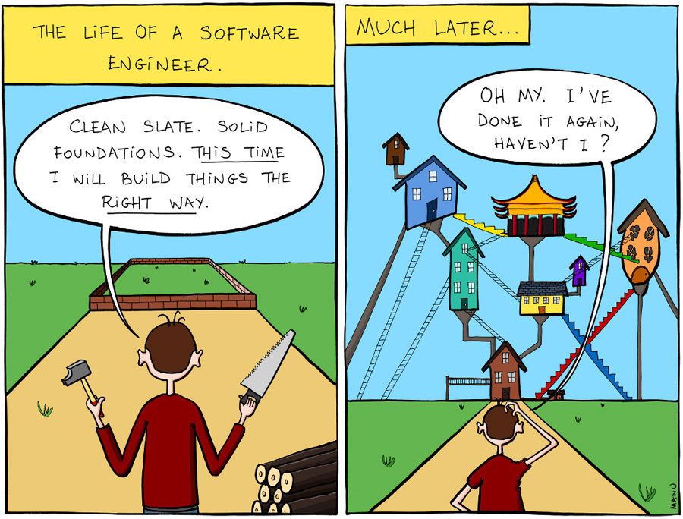
The Life of A Software Engineer

Slide 8
基于构件的泛型
构件：模块化的、可部署、可替换的软件系统组成部分，它封装了内部的具体实现并对外提供统一接口
以构件的创建、构件的管理以及复用已有构件组装形成应用为基本活动

Slide 9
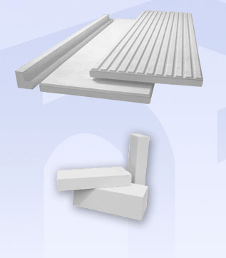
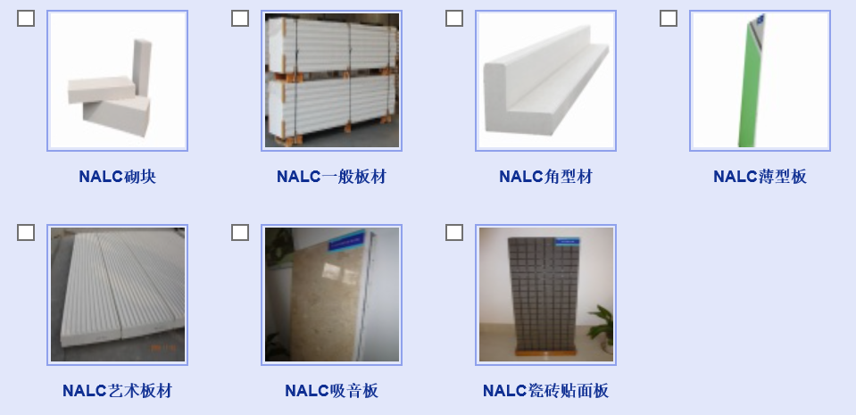
构件 vs 应用组装 （1/2)

Slide 10
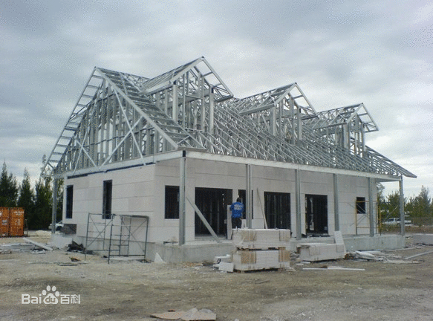
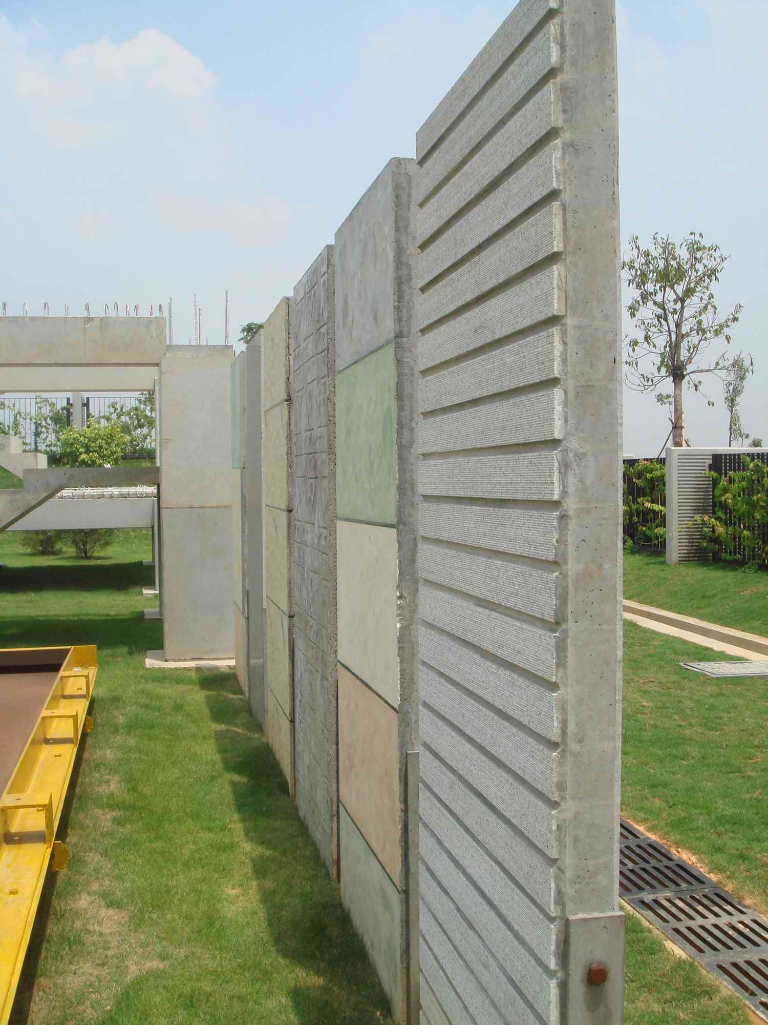
构件 vs. 应用组装 （2/2)

Slide 11
基于构件 vs. 面向对象
 | 基于构件 | 面向对象
抽象视角 | 构件是对客观世界的实体或者实体联合能提供的功能和服务的建模； 仅仅关注实体的功能和服务 | 对象是对客观世界基本实体的抽象，强调对实体的对应及对实体的建模； 涉及实体的静态属性特征
可复用程度和复用机制 | 以组合的方式实现复用 | 以继承的方式实现复用
粒度不同 | 大 | 小

Slide 12
面向服务的泛型
服务：是自治、开放、自描述、与实现无关的网络构件
以服务的创建、服务的管理以及复用已有服务组装形成应用为基本活动
通过网络，使用标准方式互联

Slide 13
While things are Service-Oriented…
Services (horizontal) are
  Function-related
  Simple and relative stable
  Developed by IT specialist
Processes (vertical) are
  Application-related
  Complex and variable
  Developed by business specialists
  Can be wrapped as services

Slide 14
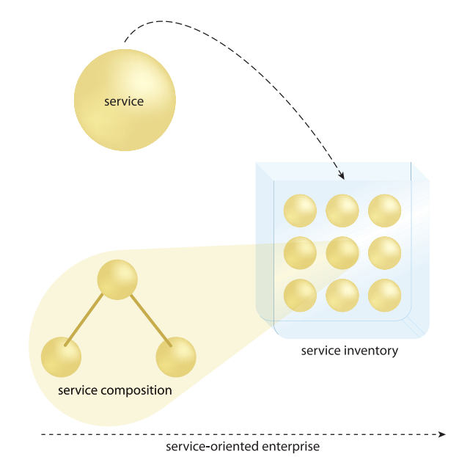
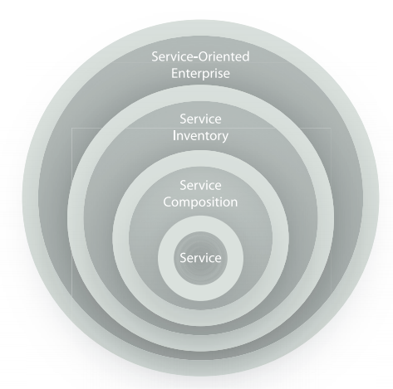
While things are Service-Oriented…

Slide 15
Service inventory
A service inventory is an independently standardized and governed collection of complementary services within a boundary that represents an enterprise or a meaningful segment of an enterprise
The inventory can be structured into layers according to the service models used
  application service layer
  business service layer (task-centric or entity-centric)
  orchestration service layer
  Before built, the service inventory blueprint is given

Slide 16
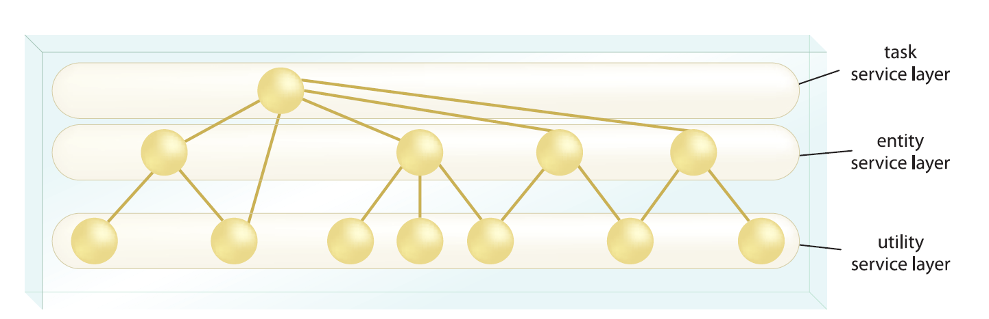
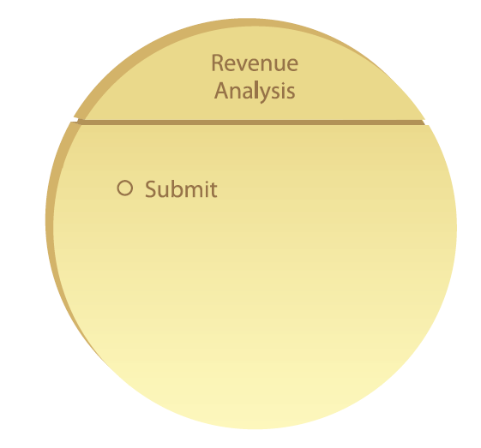
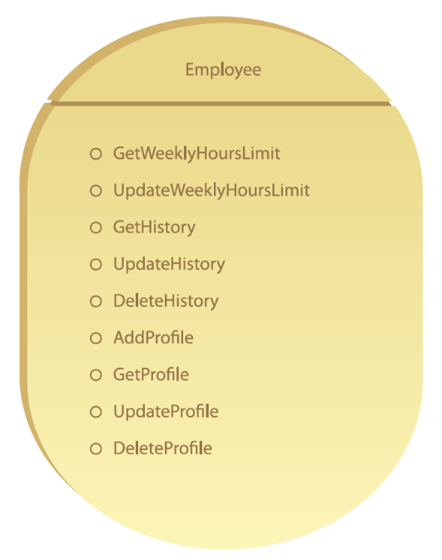
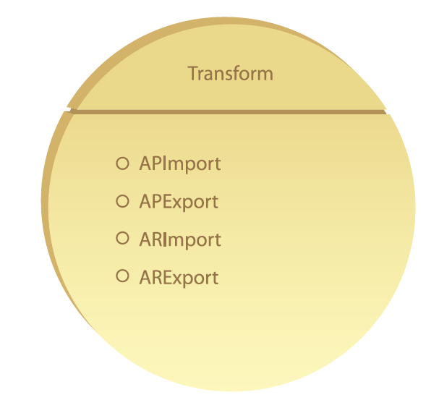
Services models

Slide 17
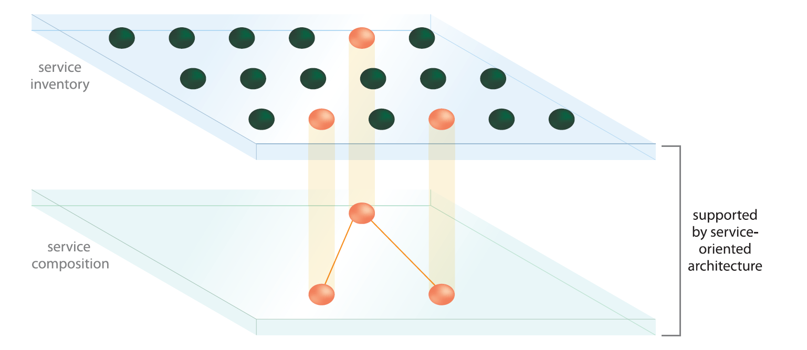
Service inventory and composition

Slide 18
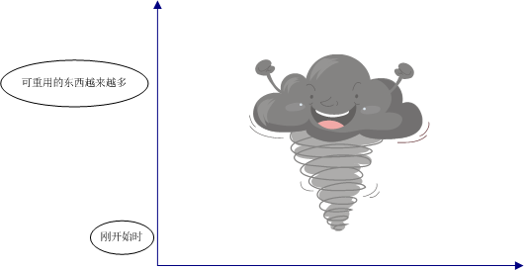
龙卷风模型

Slide 19
面向服务 vs. 面向对象 （1/3）
特点 | 面向对象的计算 | 面向服务计算
方法论 | 通过定义紧耦合的类来进行应用开发 应用架构为基于继承关系的层次式架构 从构造函数——通过类或模型——到系统设计 | 通过定义松耦合的服务来进行应用开发，并将服务组装成可执行的应用 从系统模型到服务模块，从服务抽象定义到服务实现绑定 通过搜索获得可用的服务实现
抽象和协作层次 | 往往由一个团队来负责应用的开发，并负责整个生命周期 开发者必须了解应用领域知识和编程 | 开发任务由三个独立方承担：应用程序开发者，服务提供方和服务代理 其中，应用程序开发者需要了解应用逻辑，但不需要了解具体的服务是如何实现的 服务提供者需要编程能力，但不必了解使用服务的应用

Slide 20
面向服务 vs. 面向对象 （2/3）
特点 | 面向对象的计算 | 面向服务计算
代码共享和复用 | 代码复用通过类成员的继承和库函数加以实现。其中库函数在编译时引入，且往往是平台相关的 | 代码在服务层次复用。服务使用标准的结构，并发布在Internet库中。服务是平台无关的，且能够被查找并远程调用。服务代理支持系统的服务共享
动态绑定和重新组合 | 在运行时将名称和方法进行关联。方法必须在应用部署前链接到可执行的代码 | 在运行时将服务调用和服务进行绑定。可以在应用部署后，再进行服务选定。这一特色使得应用可以在运行时重组
重组 | 多在设计时决定导入的组件 | 可以动态改变应用系统中服务的组合关系，以及服务定义与服务实现之间的绑定关系，即实现动态地添加、修改、删除各个服务节点
组件通讯和接口 | 与平台和语言有关，例如C++程序难以直接和Java程序通信 | 与平台和语言无关。组件间通过标准协议通信，如XML，WSDL和SOAP

Slide 21
面向服务 vs. 面向对象 （3/3）
特点 | 面向对象的计算 | 面向服务计算
系统维护 | 用户需要时常升级软件，且在执行升级时，应用必须停止 | 通过互联网升级系统，因为服务多运行在远程服务器上，用户通过互联网进行访问。维护对用户透明
可靠性 | 在设计时决定可靠性的方法 | 对于服务提供者，每个服务相对简单，更加可靠。对于应用程序存在多个满足同一需求的服务，可用过将故障服务的节点断开并重新绑定到备选服务节点上，获得不间断的应用系统
软件拥有 | 软件作为产品销售，为用户所拥有 | 软件存在并执行于独立的服务提供商的设备上，用户按照每次对服务使用付费，而不是按照软件产品付费

Slide 22
从设计角度…
特点 | 面向对象的计算 | 面向服务计算
耦合 | 提倡重用和松耦合，但是预先定义的类依赖导致更多的对象紧密绑定 | 服务的松耦合由功能和服务合约给定
粒度 | 为支持不同规模的任务，支持细粒度接口（API） | 鼓励粗粒度的接口（服务描述），通讯消息中包含尽可能多的任务相关信息
作用域 | 对象作用域更小，更有针对性（往往基于一个软件系统） | 服务作用域显著不同（往往基于一个服务生态系统）
前瞻性 | 鼓励处理逻辑与数据的绑定从而产生对象 | 鼓励创建活动-无关的、由消息驱动的服务
状态性 | 数据和逻辑的绑定，导致带状态的对象 | 服务尽可能保持无状态性
组合 | 在支持对象组合的同时也支持对象的继承，从而导致紧耦合 | 支持松散耦合服务的组合

Slide 23
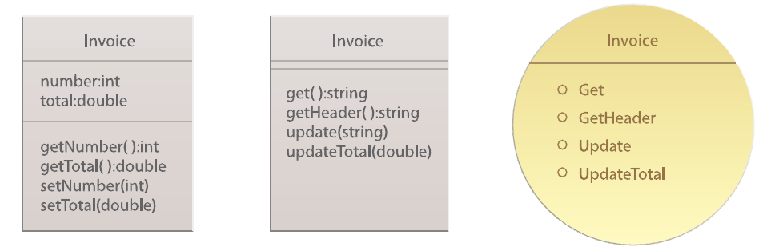
基本概念：对象/类、服务合约
“OO-Styled” class (with attribute and method)
“Service-Styled” class (without attribute)
Service contract with service capabilities

Slide 24
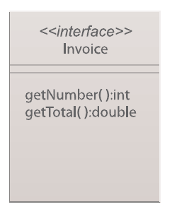
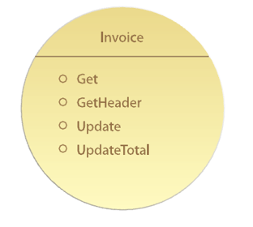
基本概念：接口/Interface & 服务合约

Slide 25
OO的基本原则（for SO?)
封装（Encapsulation）
继承（Inheritance）
泛化和特化（Generalization and Specialization）
抽象（Abstraction）
多态（Polymorphism）
开放-封闭原则（Open-Close Principle, OCP）
别重复你自己（Don’t Repeat Yourself, DRY)
单一职责原则（Single Responsibility Principle, SRP）
委托（Delegation）
关联（Association）
组合（Composition）
聚合（Aggregation）

Slide 26
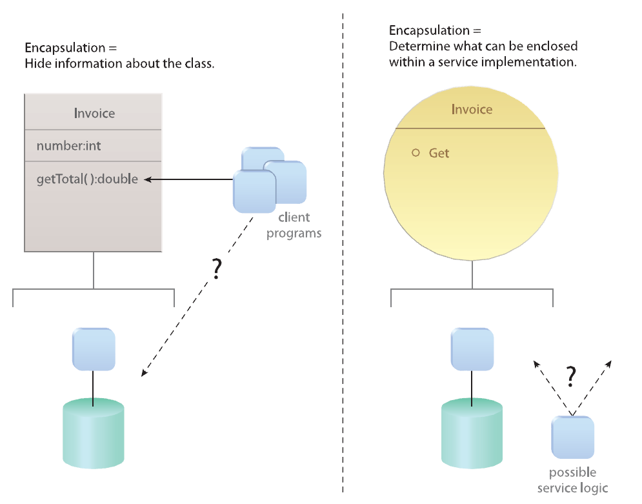
封装（Encapsulation）

Slide 27
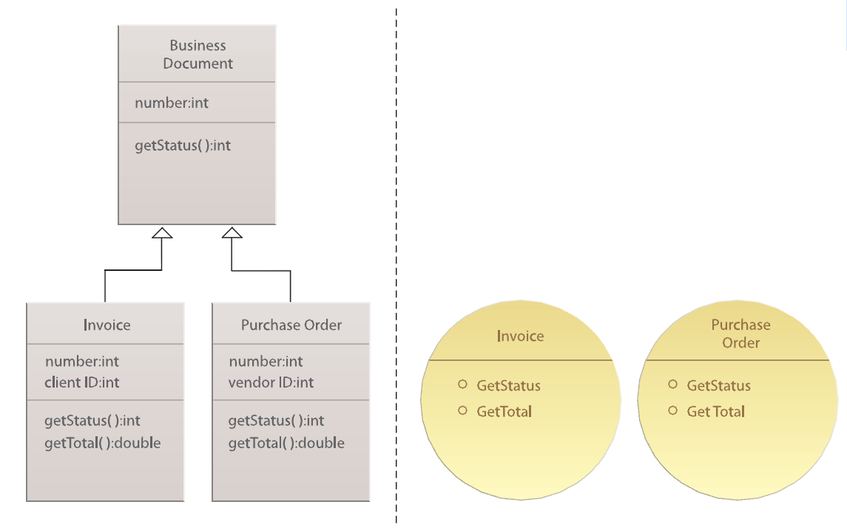
继承（Inheritance）

Slide 28
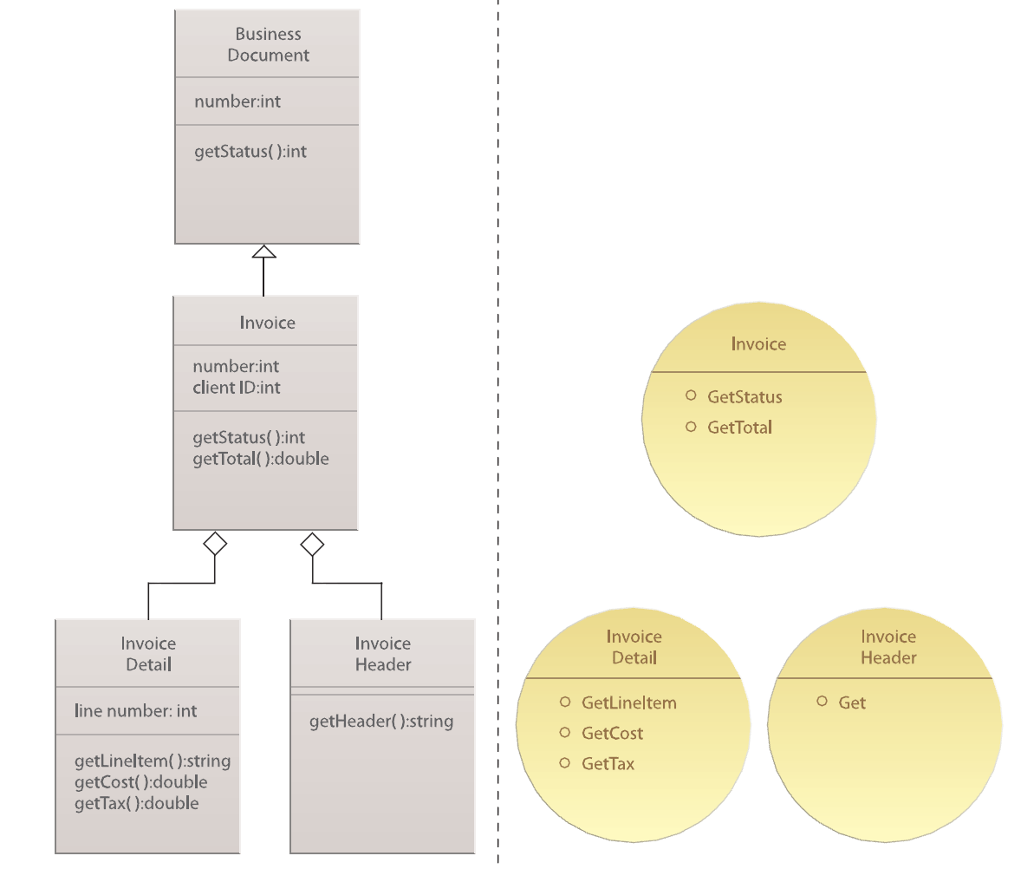
泛化和特化（Generalization and Specialization）

Slide 29
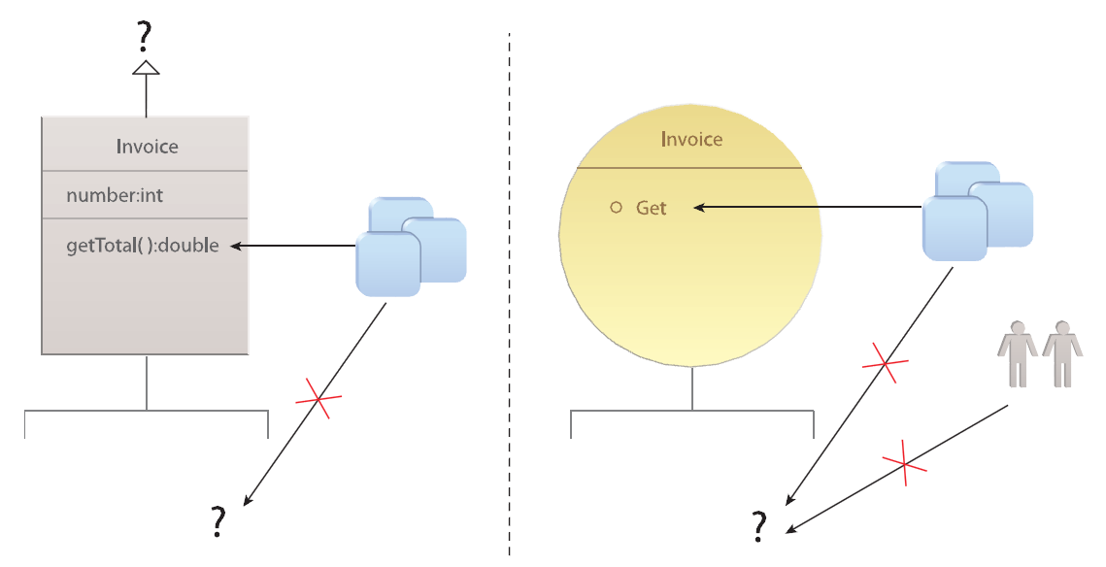
抽象（Abstraction）

Slide 30
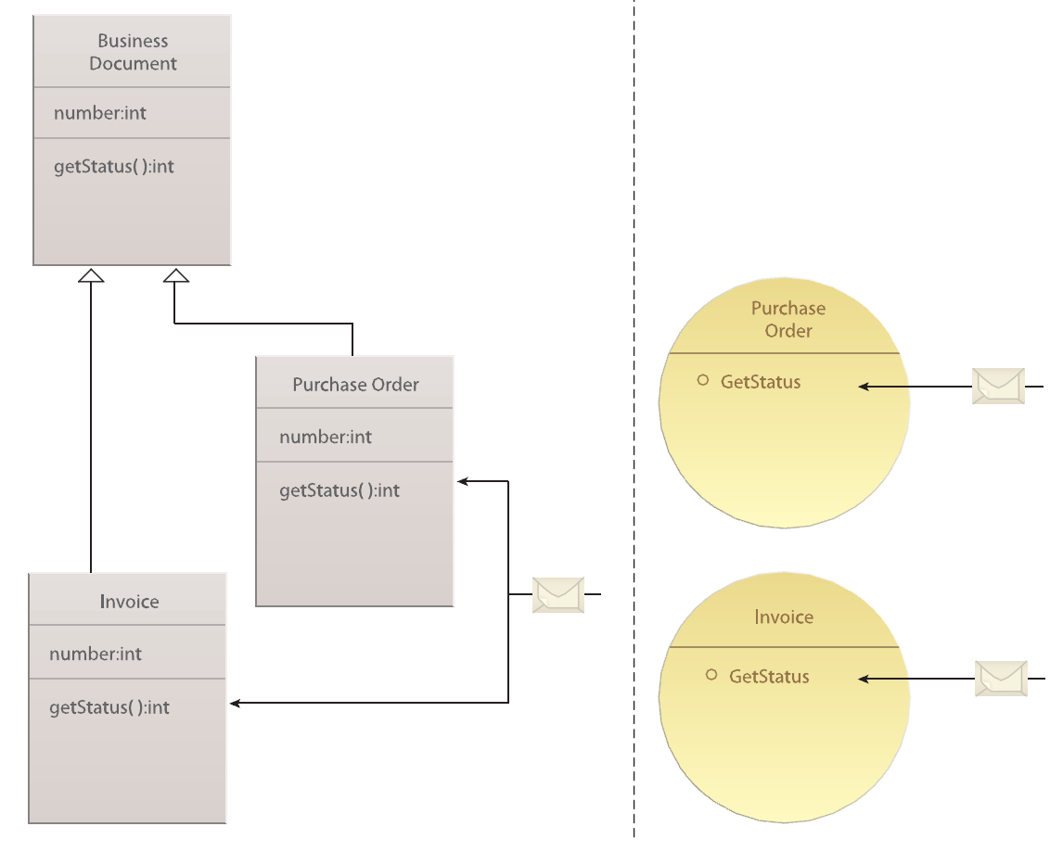
多态（Polymorphism）

Slide 31
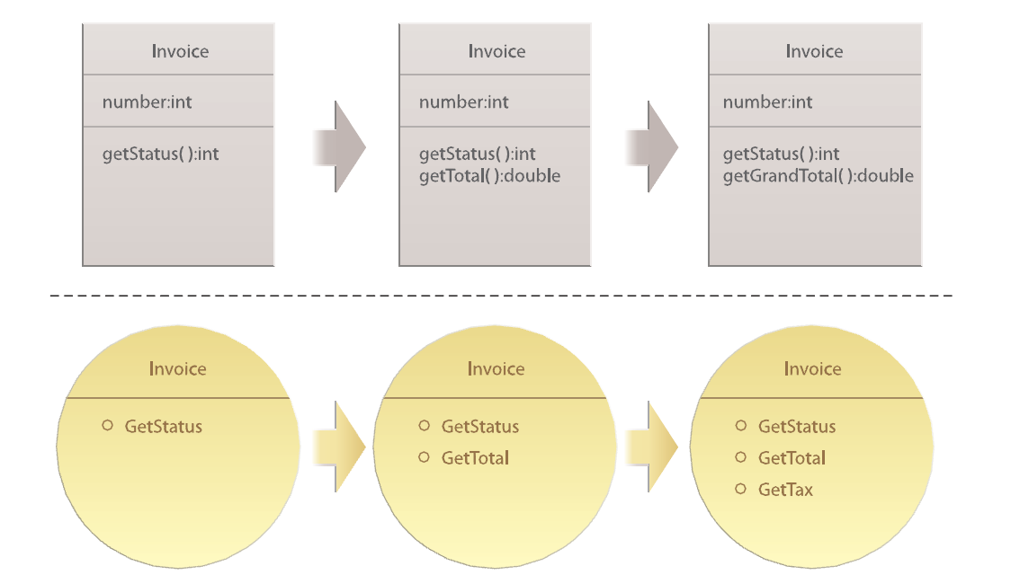
开放-封闭原则（Open-Close Principle, OCP）
X

Slide 32
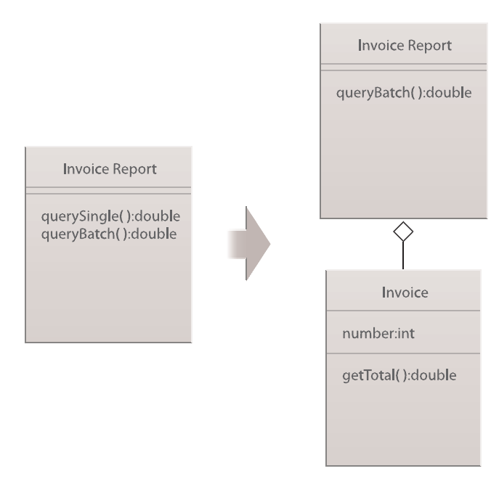
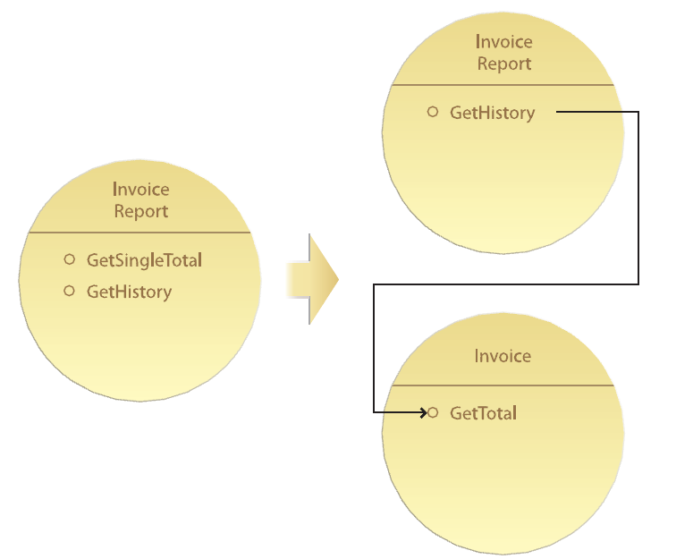
别重复你自己（Don’t Repeat Yourself, DRY)

Slide 33
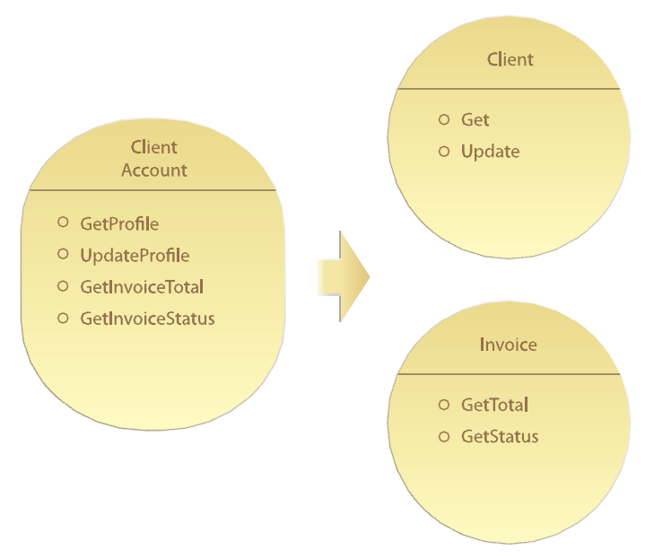
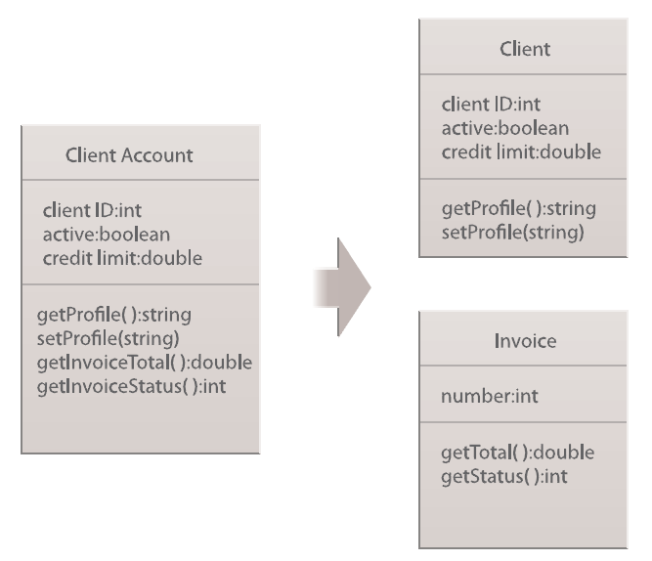
单一职责原则（Single Responsibility Principle, SRP）

Slide 34
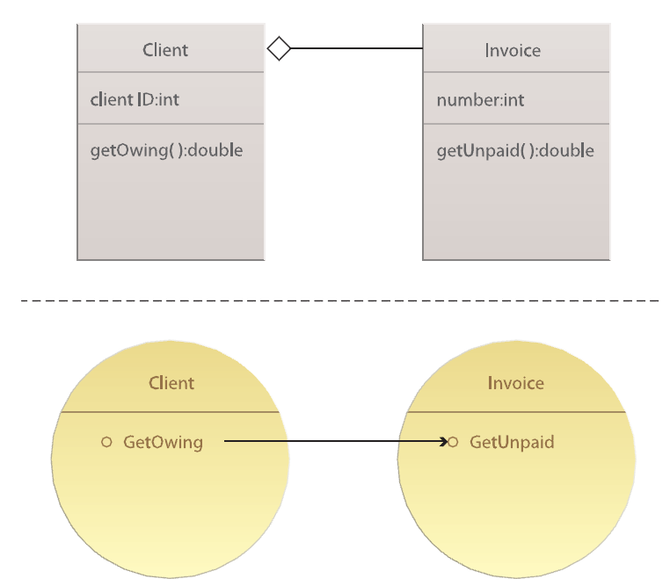
委托（Delegation）

Slide 35
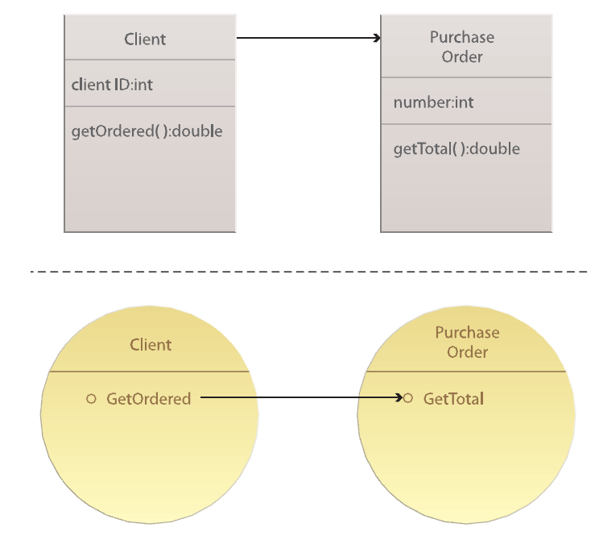
关联（Association）

Slide 36
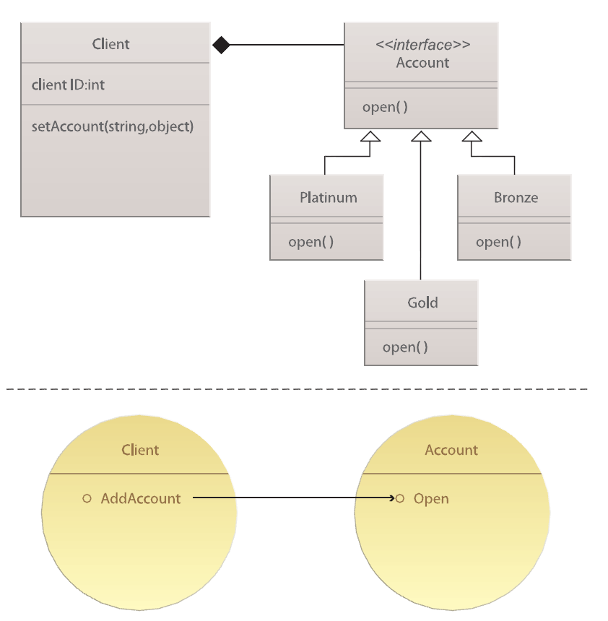
组合（Composition）

Slide 37
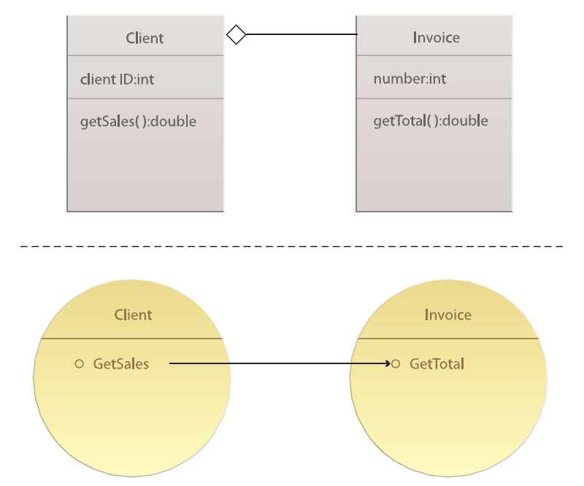
聚合（Aggregation）

Slide 38
Services Computing (1/4)
Also called Services-Oriented Computing (SOC)
从泛型角度出发
  Service-Oriented Computing (SOC) is a new computing paradigm that utilizes services as the basic constructs to support the development of rapid, low-cost and easy composition of distributed applications even in heterogeneous environments.

Slide 39
Services Computing (2/4)
从软件架构角度出发
  The Service-Oriented Computing (SOC) paradigm refers to the set of concepts, principles, and methods that represent computing in Service-Oriented Architecture (SOA) in which software applications are constructed based on independent component services with standard interfaces.

Slide 40
Services Computing (3/4)
从服务角度出发
  With the mission of bridging the gap between business services and IT services, and further enhancing business services, Service Computing covers the science and technology of leveraging computing and information technology to model, create, operate, and manage business services.

Slide 41
Services Computing (4/4)
从软件工程的角度出发
  面向服务的计算涵盖了使用服务作为基本抽象元素，采用工程化方法，对服务系统进行分析、设计、开发、测试、部署、管理等活动所涉及的理论、技术和方法
  Services-Oriented Analysis vs. OOA
  Services-Oriented Design vs. OOD
  Services-Oriented Implementation vs. OOP
  Services testing, Services Deployment and Services management

Slide 42
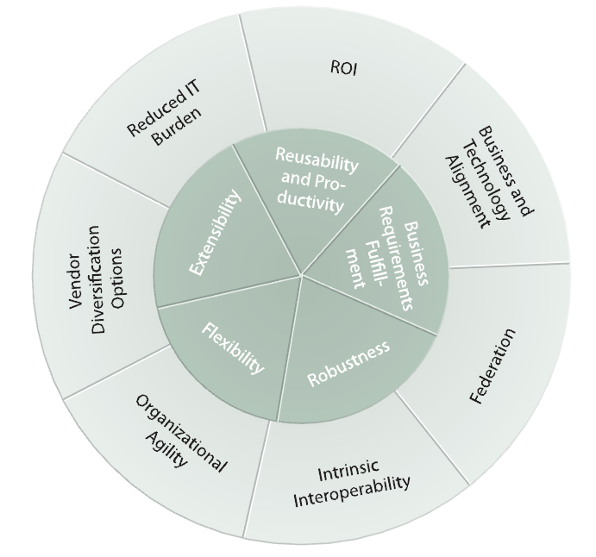
面向服务与面向服务的目标

Slide 43
Service-Oriented Architecture (1/2)
Service-Oriented Architecture (SOA) is a business-centric IT architectural approach that supports integrating your business as linked, repeatable business task, or services. SOA helps users build composite applications, which are applications that draw upon functionality from multiple sources within and beyond the enterprise to support horizontal business processes.
In software engineering, a service-oriented architecture (SOA) is a set of principles and methodologies for designing and developing software in the form of interoperable services. These services are well-defined business functionalities that are built as software components (discrete pieces of code and/or data structures) that can be reused for different purposes.

Slide 44
Service-Oriented Architecture (2/2)
SOA solution is built on reusable services accessible from Internet or service registries
Enables interoperability and integration of complex software systems in a standard way
Bridge IT and business requirement

Slide 45
Triangular SOA Operation Model
Query interface
Publishing interface

Slide 46
Concepts Related
Enterprise
Integration
Object
Oriented
BPM
SOC/SOA
CBSD
Distributed
Computing
Web
Services
CBSD: Component-Based Software Development
BPM: Business Process Management

Slide 47
Enterprise Application Integration (EAI)
Enterprise Application Integration (EAI) is the process of integrating multiple, independently developed applications that may use incompatible technology and need to remain independently managed.
  Point to point integration
  EAI based on message broker
  EAI based on distributed objects
EAI is an important application area of SOC, and ESB (enterprise service bus) can be used

Slide 48
Business process Management (BPM)
A business process is a "series or network of value-added activities, performed by their relevant roles or collaborators, to purposefully achieve the common business goal." These processes are critical to any organization as they generate revenue and often represent a significant proportion of costs
As a managerial approach, BPM considers processes to be strategic assets of an organization that must be understood, managed, and improved to deliver value added products and services to clients.
Processes can be defined, managed, used and composited as services

Slide 49
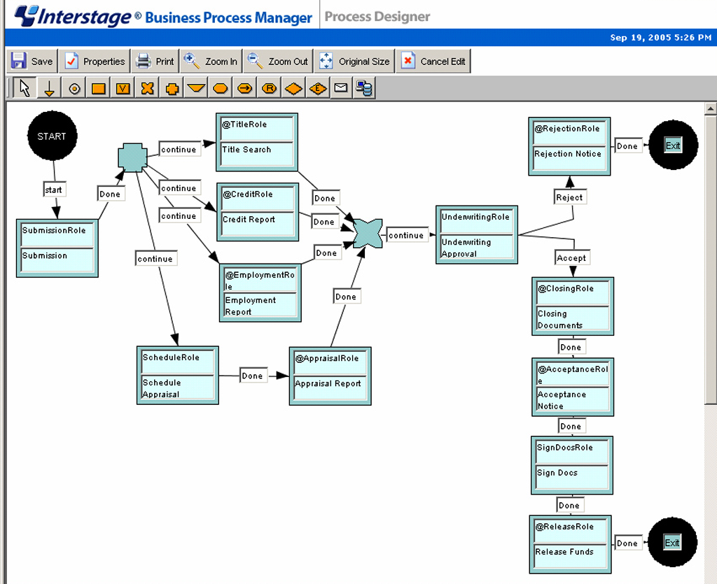
An example of Process

Slide 50
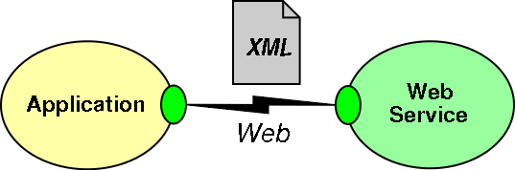
Web Services
Web Services use Extensible Markup Language (XML) messages that follow the SOAP standard and have been popular with traditional enterprise. In such systems, there is often a machine-readable description of the operations offered by the service written in the Web Services Description Language (WSDL).

Slide 51
Web services standard stack
Five layered stack has been formed

Slide 52
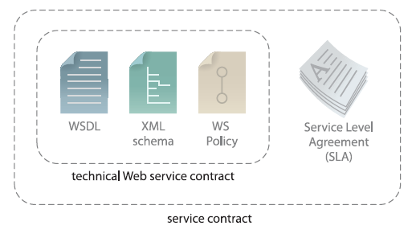
服务合约
建立了与服务交互有关的术语
提供了技术限制和需求，及服务的拥有者希望对外公布的所有语义信息

Slide 53
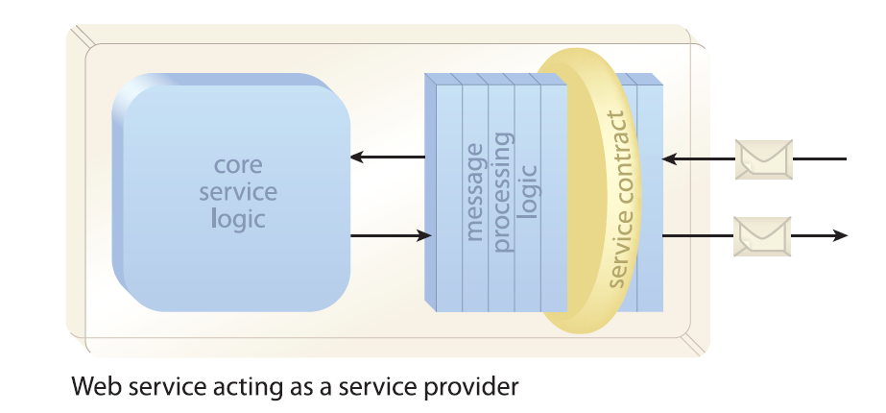
Abstract model of Web service (1/3)

Slide 54
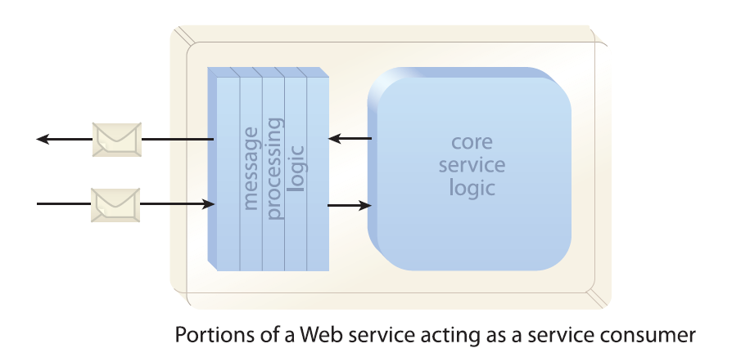
Abstract model of Web service (2/3)

Slide 55
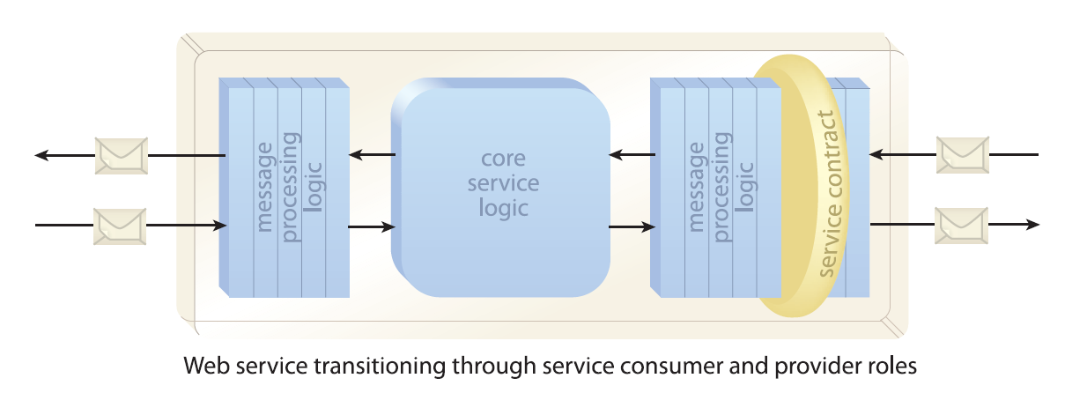
Abstract model of Web service (3/3)

Slide 56
REST风格
REST(表征状态转移,Representational State Transfer)风格
  网络上的所有事物都被抽象为资源（resource）
  每个资源对应一个唯一的资源标识（resource identifier）
  通过通用的连接器接口（generic connector interface）对资源进行操作
  对资源的各种操作不会改变资源标识
  所有的操作都是无状态的（stateless）。

Slide 57
RESTful Service
REST-style services (i.e., RESTful services) adhere to a set of constraints and architectural principles that include the following:
  RESTful services are stateless.
    “each request from client to server must contain all the information necessary to understand the request, and cannot take advantage of any stored context on the server.”
  RESTful services have a uniform interface.
    This constraint is usually taken to mean that the only allowed operations are the HTTP operations: GET, POST, PUT, and DELETE.
  REST-based architectures are built from resources (pieces of information) that are uniquely identified by URIs.
    For example, in a RESTful purchasing system, each purchase order has a unique URI.
  REST components manipulate resources by exchanging representations of the resources.
    For example, a purchase order resource can be represented by an XML document. Within a RESTful purchasing system, a purchase order might be updated by posting an XML document containing the changed purchase order to its URI.

Slide 58
一些概念和名词
Service
Services-Oriented
SOA
Web Services (XML, SOAP, WSDL as core standards)
REST, RESTful Services
JAX-WS (in JavaEE) and its implementation (including WTP project, BPEL designer Project in Eclipse)
.Net
IBM WebSphere
Other open source projects
……

Slide 59
Service-oriented Summary (1/2)
Service-oriented solution logic is implemented as services and service composition designed in accordance with service-orientation design principles
A service composition is comprised of services that have been assembled to provide the functionality required to automate a specific business task or process.
Because service-orientation shapes many services as agnostic enterprise resources, one service may be invoked by multiple consumer programs, each of which can involve that same service in a different service composition

Slide 60
Service-oriented Summary (2/2)
A collection of standardized services can form the basis of a service inventory that can be independently administered within its own physical deployment environment
Multiple business processes can be automated by the creation of service compositions that draw from a pool of existing agnostic services that reside within a service inventory
Service-oriented architecture is a form of technology architecture optimized in support of services, service compositions, and service inventories

Slide 61
Read More…
题名/责任者:浅谈深析面向服务的软件工程/蔡维德, 白晓颖, 陈以农著
  出版发行项:北京:清华大学出版社,2008
  ISBN及定价:978-7-302-17221-5/CNY29.00
题名/责任者:SOA服务设计原则/(美) Thomas Erl著 郭耀译
  出版发行项:北京:人民邮电版社,2009
  ISBN及定价:978-7-115-20492-9/CNY55.00

